Slide 1
CP³P Certification Guide
APMG Certified Public-Private Partnerships Professional (CP³P) Accreditation

Slide 2
Contents
Contents
    About the PPP Certification Guide and CP³P
    Journey to CP³P Certification
    About Us

Slide 3
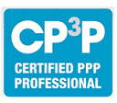
1. About the PPP Certification Guide and CP³P

Slide 4
I.1. Developing PPP Certification Program
Developing PPP Certification Program
Launched in April 2016
Innovation of Multilateral Development Banks (MDBs):
  Asian Development Bank (ADB);
  European Bank for Reconstruction & Development (EBRD);
  Inter-American Development Bank (IDB);
  Islamic Development Bank (IsDB);
  Multilateral Investment Fund (MIF);
  World Bank Group (WBG)
Funded by Public-Private Infrastructure Advisory Facility (PPIAF)
Accredited and delivered by APMG International

Slide 5
Why is the CP³P Program Needed?
It will help enhance PPP performance through:
Providing a global standard in PPP/PFI delivery thorough the world
Strong leadership and sound technical know-how at all levels
Thorough planning and adequate funding
Incorporates “Lessons Learnt” from previous experience and models
Creates a proper understanding of principles and documents

Slide 6
How will the CP³P help PPP Participants?
Enables all contributors to participate effectively throughout a PPP through:
Effective team building by bringing different disciplines together
A standardized framework that provides clarity and consistency

Slide 7
Building the PPP Certification Guide
Presents an MDB-endorsed collection of good practices structured by PPP life cycle stages
Written by a group of current PPP practitioners with extensive regional and sectoral knowledge
Reviewed by over 80 PPP experts from public, private sector and IFIs
www.ppp-certification.com

Slide 8
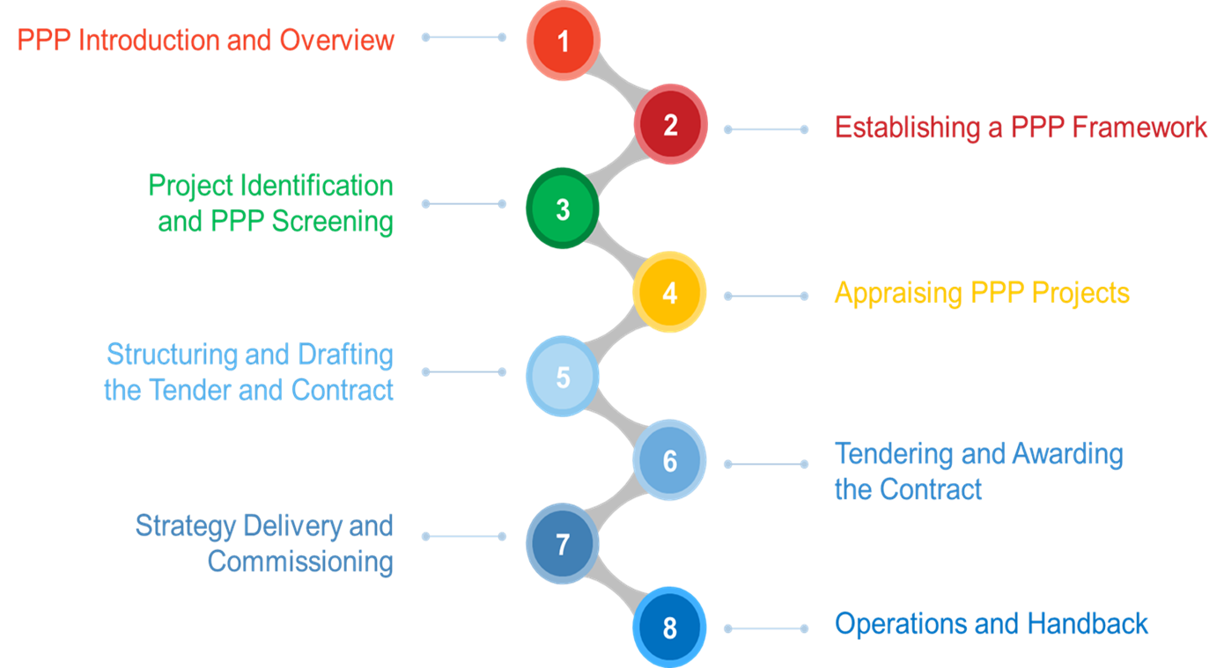
PPP Certification Guide
PPP Certification Guide

Slide 9
Use of PPP Certification
Use of PPP Certification
Best practices to preparing and delivering public investment and infrastructure development projects
Compares to and highlights international practices
Reference to all issues related to PPPs
Connection between the different areas of expertise in the PPP cycle

Slide 10
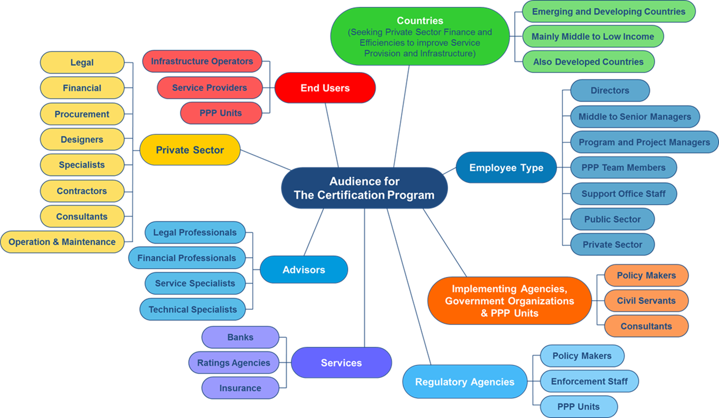
Target Audience
Target Audience

Slide 11
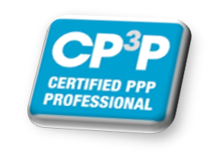
2. Journey to the CP³P

Slide 12
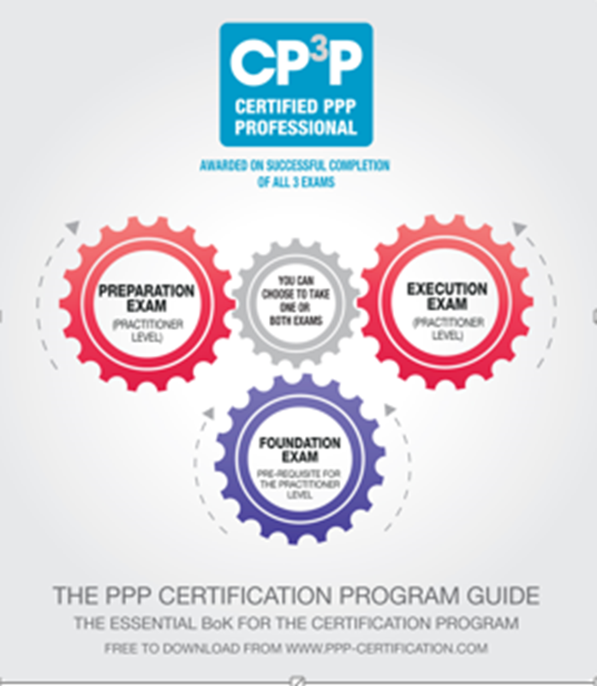
Journey to CP3P: Three exams
Journey to CP³P: Three Exams

Slide 13
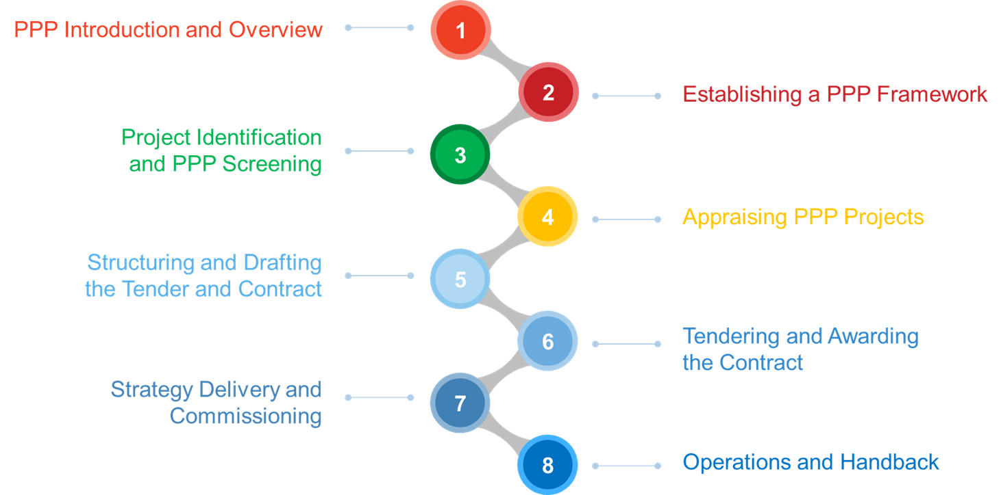
PPP Guide & CP3P Levels
PPP Guide & CP³P Levels
Currently
Available
Foundation
Preparation
Available
April 2017
Execution
Available
4Q-2017

Slide 14
Level 1 - Foundation Exam
Level 1: Foundation Exam
Pre-requisite to other two levels of exams in CP3P program
Tests understanding and knowledge of basic PPP principles and prepares for the other two levels of exams.
Considered as a minimum for anyone running or seconded into a PPP environment.
Successfully passing the exam earns a Foundation Certificate
Form of Study:
  Self-study for Foundation exam
  Classroom training – candidates can attend a 2-3 day training course offered only by APMG’s accredited training organizations (ATO) and conducted by an APMG accredited trainer.

Slide 15
Level 2 - Preparation Exam
Level 2: Preparation Exam
Tests a candidate’s understanding of a PPP Framework and application of PPP Project Identification, Screening, Appraisal and Preparation Processes in a given context.
Aimed at individuals involved in the development or implementation of PPP frameworks or the initiation and preparation of PPP projects.
Public sector officials and PPP practitioners, as well as their advisors and consultants will find the exam beneficial to enhance their delivery of PPPs.
The private sector will also have an interest in this certification to better understand the PPP concept as an asset/business opportunity, Government objectives and institutional arrangements.

Slide 16
Level 2 - Preparation Exam
Level 2: Preparation Exam
Based on chapters 2 to 5 of the PPP Certification Guide.
The exam is based on a fictional infrastructure PPP case study and candidates will be required to apply their knowledge of the PPP Guide to this scenario.
Form of Study:
  Classroom training – candidates can attend a 5 day training course offered only by APMG’s accredited training organizations (ATO) and conducted by an APMG accredited trainer.

Slide 17
Level 3 – Execution Exam
Level 3: Execution Exam
This will test a candidates understanding on how to apply the structuring and drafting process of PPP tender documents and PPP contracts, as well as the management of PPP contracts during the Construction and Operations Phases
Aimed at individuals involved in the structuring and tendering of PPP projects and the management of PPP contracts.
Public sector officials, practitioners and their advisors or consultants will find the training and exam beneficial.
Private sector candidates may benefit from a greater understanding of the PPP concept as an asset/business opportunity.

Slide 18
Level 3 – Execution Exam
Level 3: Execution Exam
Based on chapters 5 to 8 of the PPP Certification Guide.
The exam is based on a fictional infrastructure PPP case study and candidates will be required to apply their knowledge of the PPP Guide to this scenario.
Form of Study:
  Classroom training – candidates can attend a 5 day training course offered only by APMG’s accredited training organizations (ATO) and conducted by an APMG accredited trainer.

Slide 19

3. About Us

Slide 20
Training Byte Size
Training ByteSize
Training ByteSize have been delivering accredited training in operations, portfolio, programme and project management for over 15 years.
We see CP3P training as a part of the complete programme lifecycle, from business case development through to successful delivery, providing best practice, clear structure, templates and guidance.
Our trainers are experienced practitioners as well, and bring a wealth of knowledge and experience of PPP implementation, and real life experience.

Slide 21



Thank You
Thank you
Offices in:
United Kingdom +44 (0)1270 626330
Australia and New Zealand +61 (02) 8072 0653
Canada +1 (905) 581-5090
Middle East
Offices in Canada and the Middle East are
Covered by our Partner Toraza Zenith Inc
learning@trainingbytesize.com
www.trainingbytesize.com

